Slide 1
University of Diyala / College of Engineering Department of Chemical Engineering Windows 7
Preparing Lect. Omar A. Imran

Slide 2
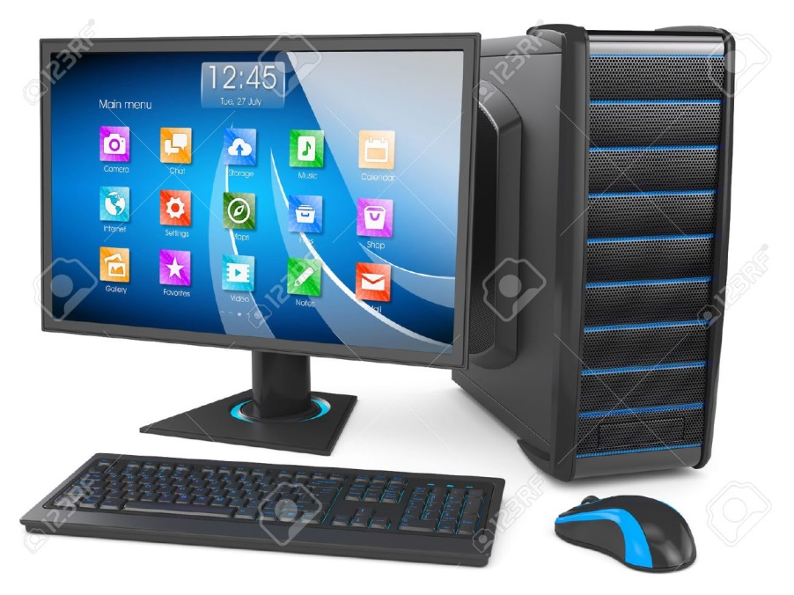
the Second lecturer
Fundamentals interface Windows operating system: -
Desktop :
Desktop represents the main area of ​​the screen that appears after the computer starts, works in the desktop computer as the roof of your business, you can practice it.

Slide 3
Taskbar:
Is a long horizontal bar at the bottom of the screen. Unlike the desktop that can disappear behind open windows, the taskbar is often visible all the time.

Slide 4
Taskbar consists of three main sections:
button 'Start' , which opens the Start menu.
middle section, which shows programs and open files and allows you to switch between them in an expeditious manner.
part notifications, which includes an hour and icons (small pictures) which refers to the case of some programs and some computer settings.

Slide 5
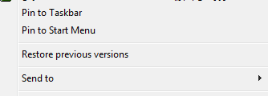
To view the program in the taskbar Task bar, follow these steps: -
click, right-click the program you want to display at the top of the Start menu.
of the sub-menu that appears, as in the following figure choose Add to the list the "Start" (Pin to Taskbar).
program is displayed in the list of items added in the region, the highest line in the Start menu.

Slide 6
Delete the program from the taskbar Task bar, follow these steps: -
Click Right-click the program you want to delete it at the top of the Start menu.
Of the sub-menu that appears choose Add to the list the "Start" (unpin this program from Taskbar).
is deleted the program taskbar Task bar.

Slide 7
Menu (Start)
The list "Start" main gate to computer programs and Mozart and settings. The list of so-called because they provide a list of choices, and it seems from the word 'Start', is this list is the place to move him to start or open things. You can use the menu "Start" to do these common activities: -
Start programs
Open folders commonly used
Search for files and folders, and programs
Adjust your computer's settings
Get help for Windows operating system
Turn off your computer
Log off from Windows or switch to another user account

